Slide 1
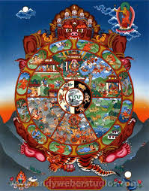
PRACTISING THE PRELIMINARIES
POINT ONE
Our Precious Human Rebirth
Death and Impermanence
Samsara
Karma
1
Notes:
The preliminaries are the basis for understanding our minds and the nature of existence.
These are huge topics that we can introduce and then return to throughout the course.
They are several courses in themselves.
PHR –
Appreciation of our PHR. It is not enough to have it, We must utilise what it offers
Its rarity
Its fragility
Human abilities as compared with other kinds of being – being human is because of the practice of ethics
If we don’t recognise how meeting the dharma is offering us a way out of prison, then it is not much use to us
Death and Impermanence –
Denial of death
Change – 3 types of suffering: mental and physical pain, pervasive and change
Samsara – circling, trapped, in prison, seeing it as not a realm of pleasure but a prison
Karma – everything we experience is a result of our karma
Conditioned existence
1

Slide 2
THE WHEEL OF LIFE
A SYMBOLIC REPRESENTATION
OF
CYCLIC EXISTENCE
(i.e. life, death and everything else in between as explained by The Buddha)
Notes:
By looking at the Wheel of Life we can we can contemplate all these preliminaries.
As explained by Guru Shakyamuni Buddha – gift to King Rudrayana (as in Daryavadana). For simple folk – the illiterate and uneducated. A powerful visual image.
How did the Buddha know? – in his enlightenment could see.

Slide 3
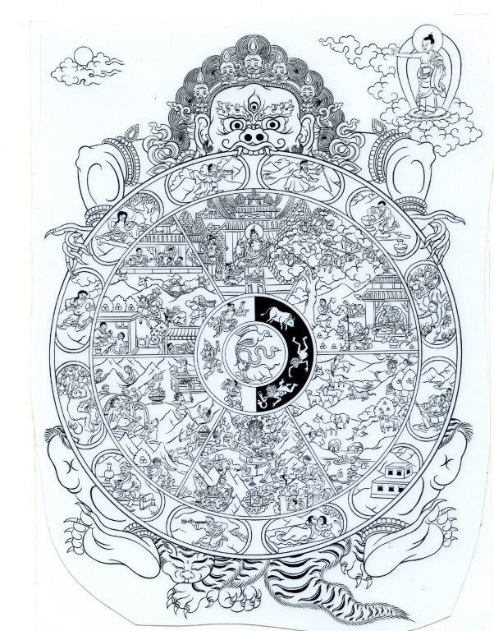
The Wheel of Life and the Twelve Branches of Dependent Arising
Due to the existence of this,
that arises.
Due to the production of this,
that is produced.
Notes:
Lord of Death – Yama
5 skulls – 5 aggregates – form, feelings, compositional factors ( karma), volition, consciousness
3 eyes wisdom
Tiger skin – fearlessness
4 limbs – sufferings of birth, sickness, old age and death
6 realms of rebirth in the Desire realm. Also formless and form realms.
Buddha is pointing to nirvana
E.g. we are hamsters on wheels. We live as if we have choices, but are mainly driven by conditioning and karma, and a strong desire to BE - self grasping.
Bhava chakra – wheel of becoming (Sanskrit)
Our minds like puddles; Dr. Brian Cox (physicist) like ponds; Einstein a lake: Buddha the ocean. Incredible, inconceivable abilities of enlightened mind.
When explained it is not like a fairy tale – we can relate it to our experience so it feels more like science rather than fantasy. It makes sense. It’s not faith – religious idea – but quite a deep psychological explanation of how we operate.
Main segments: 6 realms of samsara – cyclic existence
Outer rim: 12 links showing HOW we bind ourselves through ignorance and delusions.
Held by death (Impermanence)
AFFLICTIONS: like disabilities – but with effort we can work with our afflictions to become healed.
The Wheel is a call to action: a rebellion against the prison of selfishness - what Jeffrey Hopkins calls the “counterproductive maelstrom of suffering” – how we can overcome it.
Applying antidotes that focus on altruism makes our life meaningful and ultimately liberates us as shown by the Buddha pointing to the moon. The path – to liberation.

Slide 4
Pig: IGNORANCE Pigeon/Cockerel : ATTACHMENT Snake: AVERSION “Make effort to destroy it, Enter the Buddhadharma, Eliminate the Lord of Death, Like an elephant destroys a grass hut. Whoever takes up the practice of Ethics, With great conscientiousness, Abandons the cycle of rebirth And thus brings an end to suffering.” Buddha
Notes:
The hub of the wheel of life depicts the three poisons, our main root delusions from which all other delusions arise –
Hub: ignorance, attachment, aversion
Outer hub: karma up and down
Surrounding the hub are the karmic directions in which we travel from life to life, without control.
WoL at entrances to temples
Public teaching tool to show that practice of Ethics loosens control of 3 poisons over our karma
Other root delusions – desire, anger and pride, doubt and afflictive views (see “The True Cause of Suffering”)
Attachment and aversion coming out of mouth of ignorance
PHR
8 Leisures from hell, animal, hungry ghost and god realms and Buddha has appeared, there is Dharma, we can sense the teachings (see, hear), we don’t have wrong views
10 endowments: human, access to the religion, we function well, haven’t committed a heinous crime, have faith, a fortunate time, dharma has been taught, it flourishes, we can meet other followers, we get support
Useful in every way – relationships, achieving goals
Difficulty in obtaining it – a turtle, vast ocean, golden ring, once every hundred years
Caused by ethics, generosity and prayer
Death and Impermanence
Think about death every day
Sleep like death, dreams like the bardo, waking like rebirth
Distractions of worldly concerns
Thinking that death will not happen
The time of death is certain
The time of death is uncertain
Only Dharma helps at death
Impermanence of stages of life, securities, relationships, jobs
Samsara
Suffering – pervasive, impermanence, physical/mental
In the different realms
As psychological, realms of existence within human realms, actual as described realms
Karma
Is definite
Imprints increase
If you didn’t do it, you won’t get the result
Nothing is lost
KLZR – 95% of what we experience is due to karma
It can be purified but not totally
10 non virtuous actions – killing, stealing, sexual misconduct, lying,slander, harsh speech, gossip,covetousness, ill will, wrong views
Throwing and completing karma

Slide 5
Twelve Branches of Dependent Arising first and second
Ignorance. Of how we exist. Symbolised by a blind man.
Compositional Action or Karma. Ignorance leads to the creation of karma as symbolised by the Potter
Notes:
Our aggregates are appropriated due to actions contaminated by ignorance and the afflictive emotions. All in the nature of suffering.
Destroy ignorance, destroy the arising of our aggregates.
Compositional actions is one of five aggregates. (consciousness, form, feeling, discrimination)

Slide 6
Twelve Branches of Dependent Arising third and fourth
.
3. Consciousness. Karma creates our reality as symbolised by the monkey - karmic imprints joining past to present and present to future.
4. Name and Form. Mental and physical aggregates are generated from consciousness as symbolised by the man in the rowing boat. The boat is form and the person is the five aggregates in the fertilised egg.
Notes:
The monkey swinging from tree to tree – just like us swinging from past to future
Consciousness is an aggregate.
Our name and form are karmically created
Form is an aggregate.
Consciousness bearing karmic imprints joins past to present and then future… unless become enlightened.
Today also name and form is number 4 and 5th is six senses
What makes a human being
5 AGGREGATES: Use description. Point being there is no “I”. Robina’s description of Kerry looking in the IKEA box. All the bits. Where’s Kerry?
The person inside the fertilised egg.
Boat is agg. of form is an aggregate
The person rowing is other aggs.
Karma is driving force

Slide 7
Twelve Branches of Dependent Arising fifth and sixth
5. Six Sense Spheres. Name and form generate the six powers of the senses. This is symbolised by the empty house - the embryo inside the womb – senses without sense objects.
6.Contact. The six sense spheres generate contact as symbolised by a couple embracing – the meeting of senses with sense objects and consciousness
Notes:
Our contact with objects generates attachment and aversion as we are attracted or averted to sense objects.
E.g. relationships! We see what we like, we are attracted.
We the see the same object but due to afflictive emotions arising (they hurt me) we don’t like it.
Discrimination/recognition/perception – one of 5 aggregates - arises through contact
Six sense spheres - senses without sense objects and consciousness
Use extra slide (6)
Discussion/Feedback
Finding the “I”
Meditation on finding the “I”

Slide 8
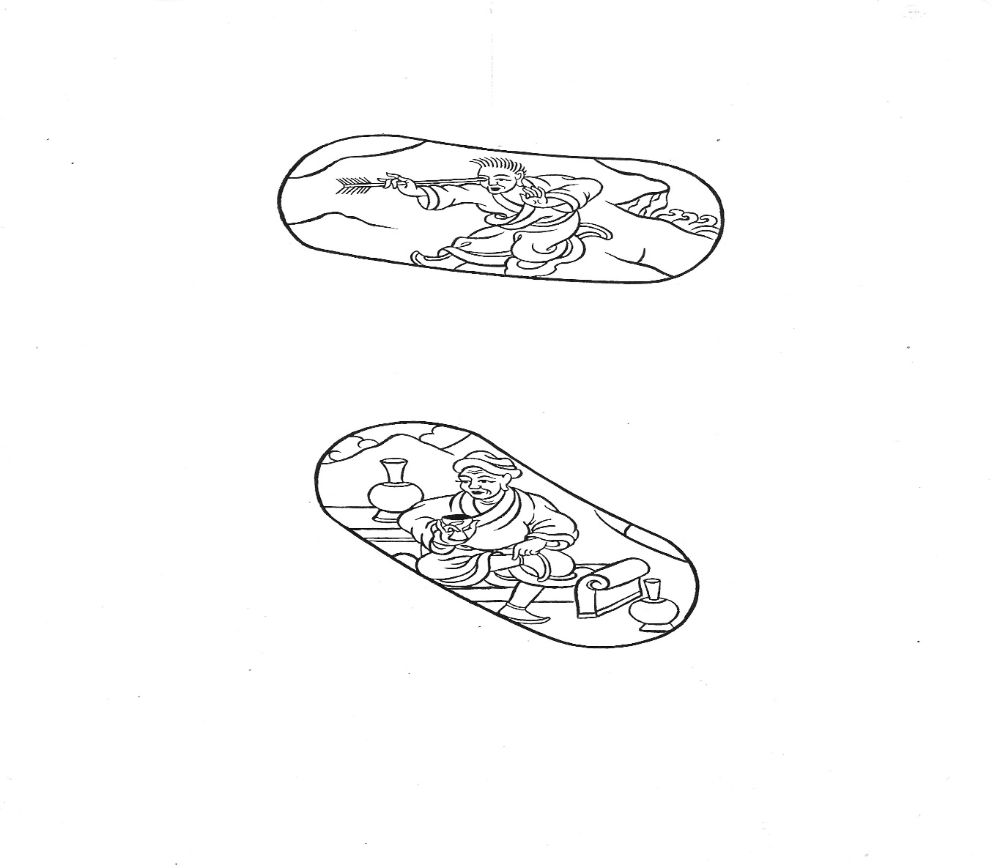
Twelve Branches of Dependent Arising seventh and eighth
7. Feeling. Contact generates feeling as symbolised by the man with an arrow in his eye. The three kinds are pleasure, pain and neutral.
8. Craving. Feeling generates craving symbolised by the wine drinker. Not wanting to separate from pleasure and wanting to separate from pain.
Notes:
Feeling is an aggregate.
Once feelings arise through contact then we need awareness.
An opportunity for mindfulness – watching our feelings of pleasure and displeasure.
8 Worldly Dharmas – wanting and not wanting
Feelings/sensations (Vedana) (is an aggregate) is the 7th link. Due to contact between our senses and a sense object, feelings arise of pleasure, displeasure or neutral. Based on ignorance that believes in an inherently existing “I” that generates attachment and aversion. So attachment and aversion are prompted by feelings. Mindfulness of feelings enables us to become aware of the subtle creation of these feelings. It enables us to monitor them and to let them go rather than following them that leads to craving.
Eight Worldly Dharmas:
craving for pleasure of the 6 senses and to be free of the unpleasant (hedonism)
craving to be admired (ego pleasing words) and not to be criticised (fame and status)
craving to have material goods and not to lose them (materialism)
craving for praise and to avoid blame (praise and blame)
Craving is the 8th link. Sometimes called thirst. (Trishna). To hold onto that which gives us pleasure and to avoid that which does not. Excitement is preferable to neutrality of feelings. It supports our sense of “I”. Neutrality suggests no feeling so equanimity preferable as it generates compassion. Also emptiness.
The Second Noble truth is There is Desire.(1st. There is suffering). The second is the cause of suffering is desire.
Due to ignorance there is craving (desire). They are the cause because they are the root of suffering.
They are the source because they give rise to suffering.
They are also called strong production because they cause severe suffering. Not just dissatisfaction.
They are conditions because they act is co-operative conditions for suffering to be generated.
If we don’t move on to cessation and path (the third and fourth noble truths) then we grasp. The Path is the way to end grasping. Renunciation enables us to release our grasping and to affect our craving. We’re pouring water on the flames of our addictions. Starving our hunger rather than feeding it.
Life is unsatisfactory so we crave and grasp. We are trying to get satisfaction from external objects. We misunderstand the source of genuine happiness because we are ignorant. Our “I” is not substantially existing.

Slide 9
Twelve Branches of Dependent Arising ninth and tenth
9. Grasping. Craving generates grasping. The monkey picks fruit from a tree symbolising wanting more and more and never being satisfied. More profoundly, humans grasp at their physical bodies.
10. Existence. Grasping at the body generates existence as symbolised by the pregnant woman. Karma is actualized for the next rebirth.
Notes:
We obsess. We want more. The then need to replace the object of attachment. We mistakenly believe pleasure to come from the sense object.
Existence continues.
The 9th link is Grasping. (Upadana) If the object of our desire is fulfilled then craving turns into grasping. We want more and more. This is the junkie mind – it’s never enough. It brought us pleasure so we’ll just keep holding on to it.
Discussion/FeedbackDiscussion Point:
“Spending this perfect human rebirth desiring only the eight worldly concerns and working for the enjoyment of samsaric pleasures is like trading universes full of jewels for ka-ka”. (Lama Zopa Rinpoche)
What Dharma tools do you find most effective in averting craving of the 8 Worldly Concerns?
Meditation on Mindfulness of Feelings /Desire.
10th link Existence.
Grasping at the body generates existence as symbolised by the pregnant woman. Karma is actualized for the next rebirth.
Just like a woman with a fully developed foetus in her womb is ready to give birth, our karma is ready to drop into our existence. The karma is fully potentialised.
Example of animals becoming animals – the puddle, the pond, the lake, the sea. If we have been grasping onto our puddle we cannot create the cause for the pond.

Slide 10
Twelve Branches of Dependent Arising eleventh and twelfth
11. Birth. Existence generates rebirth as symbolised by the woman giving birth.
12. Ageing and death. Once we are born we start to age and then will die as symbolised by the old man carrying a corpse.
Notes:
And so we go on
Sickness, ageing and death are the sights that prompted the Buddha to question the reality of genuine happiness arising from rebirths.
ALL CONTAMINATED AGGS DUE TO IGNORANCE.
DESTROY IGNORANCE, DUE TO PRACTICE OF ETHICS, AND REALISATION OF EMPTINESS
Action ceases, consciousness ceases, etc no birth, sickness, ageing, death.
BOOM!
The 11th link is Birth
Existence generates rebirth as symbolised by the woman giving birth.
Our rebirth is determined by our karma.
The 12th link is Ageing and Death
Once we are born we start to age and then will die as symbolised by the old man carrying a corpse.
Inevitably birth creates the cause for ageing and death and so it goes round again.
Return to SLIDE 3 for ignorance and recap.

Slide 11

Understanding the Arising of our Becoming
(or how we get to be us)
Two lifetimes
Three lifetimes
Realms of existence as actual places for rebirth
Realms of existence as witnessed in our realm
Realms of existence as psychological realms of experience
Observing how these links to becoming are apparent in our everyday experience
12 Nidanas (Sanskrit) – both outer (over several lifetimes) and inner (in one particular action in an interdependent manner)
Imagery supplied by Andy Weber www.andyweberstudios.com
Notes:
In one lifetime, motivated by ignorance (self-grasping and misunderstanding the nature of reality) we create karma which is infused in our consciousness
Near the time of death , a next lifetime (OR ANY NUMBER OF LIFETIMES IN BETWEEN) due to the karmic power increasing because of our craving and grasping we generate existence, we experience name and form, 6 sense consciousnesses, contact, feeling, birth, ageing and death.
The karma is actualised at its fastest in two lifetimes.
At the longest, 3 lifetimes, according to HHDL.
E.G. we kill someone in this lifetime. There may be many lifetimes in between, but the karma is fused in the consciousness (store, subtle) and then the name and form etc. arises due to that karma e.g. a short life, a place of killing, rebirth in a lower realm, the habit to kill
Realms of existence are seen literally but we can also experience these as psychological realms which we experience in a lifetime
Similarly, we can see 12 links in a lifetime – in an action
E.G.
1. I am motivated by ignorance and
2. …engage with a driver who appears to think I entered the main road from the side road without recognising they were close behind, due to my compositional factors.
3. This potency is infused in my consciousness
4. My consciousness arises from my identity as Ondy Willson (name and form) from past karma
5. I react to the event with my 6 senses – seeing their frustration in the flashing headlights, and hearing the honking of their horn
6. My senses make contact with these sense objects
7. It is an unpleasurable feeling
8. Anxiety arises because I crave for people to like me and I don’t like upsetting people
9. I grasp onto all the reasons why I’m right and how they were wrong and then all the reasons why they were right and I was wrong
10. It increases my karmic propensity of me ego grasping and I compound my anxiety into existence by telling my friends as I search for justification
11. The event of this particular road rage is born
12. Eventually it passes – ageing and death
BY applying MINDFULNESS TO OUR FORM, FEELING, THOUGHTS AND PHENOMENA we can avoid making negative karma.
By being ethical we can we can avoid actions like killing the driver
By applying the view of emptiness we see the illusion of everyday events and our ego grasping. – unravelling dualistic thinking and reactions
Understanding the arising of our becoming
HHDL says:
When we overcome ignorance, the suffering aggregates appropriated through contaminated actions and afflictive emotions cease. Otherwise the cycle goes on.
Each cycle is completed in 2/3 lifetimes.
1st life we engage in an action (e.g. we steal). This then is infused in our consciousness with the karmic potential. Our craving and grasping at the time of death (for our physical bodies) nourishes that karmic potential which when fully potentialized becomes EXISTENCE. And so we experience the effects of existence with name and form, 6 senses, contact, feeling, etc.
HHDL says that the longest one cycle of 12 takes is 3 lifetimes. The potency is deposited in the first 3 links (ignorance, karma and consciousness) then at the end of a later lifetime (with any number of lifetimes in between) craving and grasping nourish that particular potency thereby actualising the 10th link, existence. Then in the very next lifetime the remaining dependent arisings are actualised.
E.G.
Deirdre is born, named and labelled. Deirdre’s conditioning and tendencies lean towards dishonesty. Deirdre steals and has the habit of stealing – clothes, handbags, whatever she can stuff under her jumper. It’s infused in her consciousness that she will take whatever she can for free. When she dies, she craves and grasps onto her body because she doesn’t want to die and does not understand the nature of reality. She is ignorant. Her existence is not purified by emptiness so she is born and due to her ignorance, karma and the potency of stealing in her consciousness she has the potential for her karma to actualise. Either in this next lifetime or in another all the other dependent arisings will be nourished by this particular potency. This will lead to existence, and so it goes.
The karmic result could be:
Ripened – rebirth in a lower realm
Results Similar to the Cause – poverty loss of possessions, loss
Actions Similar to the Cause- the tendency to steal
Environmental – rebirth in a barren place, shortage of food, bad weather, business failures
Deirdre could have good karma ripening in the lifetimes in between but will suffer her destructive karma of the other 9 links in a second or third full lifetime.
Discussion/Feedback
This is like committing a crime, being put in jail, and committing more crimes while in jail. Thus until ignorance is removed, it is as if endless – there does not seem to be any way to end it. That is why samsara is called a prison, and no matter what one does, even engaging in virtue one can only reap the limited effects within samsaric existence. HHDL
Understanding and meditating on these preliminary teachings gives us the basis for developing the view of emptiness and compassion
Three Principal Aspects of the path – Renunciation Wisdom and Compassion
Three Marks of Existence:
Suffering, No Soul and Impermanence

