Slide 1
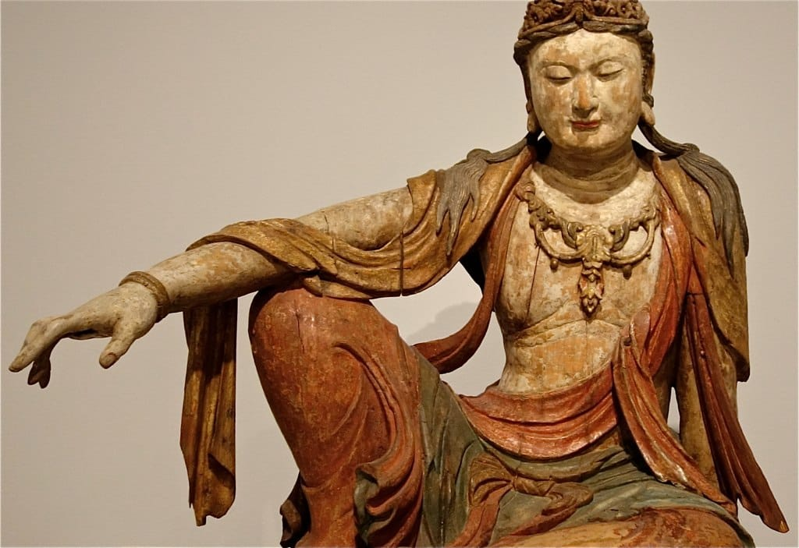
THE MAIN PRACTICE POINT TWO
AN INTRODUCTION TO WISDOM AND BODHICITTA
Notes:
The Three Principal Aspects of the Path are Renunciation, Bodhicitta and Wisdom.
By contemplating the preliminaries we develop renunciation.
This session we’re getting an overview of the other two principal aspects of the path - Wisdom and Bodhicitta
The place of Emptiness in Buddha’s teachings
3 Principal Aspects of the Path
Renunciation recognizes that life is samsara and focuses on an inner life (Nangpa)
You are now practising Nangpas!
Wisdom is then the goal and how to attain it. Hence teachings on Emptiness to destroy self-grasping
Bodhicitta – is the method for destroying self-cherishing
Having the right view is the prerequisite of the training. The correct view of emptiness – the realization of emptiness must be dissolved and released in itself. “ Let even the antidote (opponent force) be freed in its own place. “
“Alaya” – unborn awareness – home – a level of consciousness that is free from comings and goings “Thoughts are like tourists, they come and they go. Your mind is the permanent resident.” Lama Yeshe.
Practise being in space-like meditative equipoise.
Keep the mind in the direct negation of independent self-existence of both ego and the self’s identity of external phenomena.

Slide 2
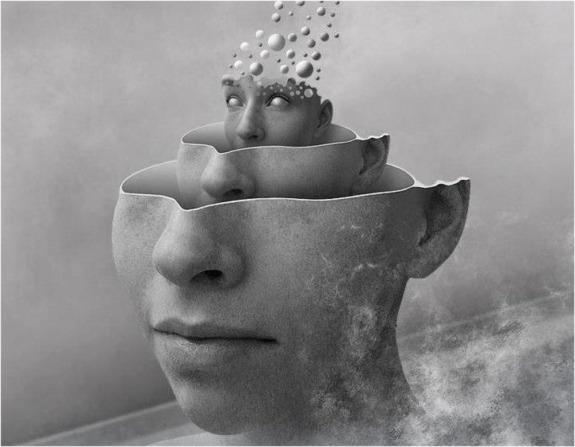
TRAINING IN THE TWO TYPES OF BODHICITTA
Conventional/Relative and Ultimate Bodhicitta
Mental stability
Emptiness – insight into the nature of reality
Grasping
Giving and Taking – the cultivation of conventional Bodhicitta
Notes:
The definition of ignorance is “a consciousness conceiving inherent existence” – that which is ego-grasping.
Wisdom consciousness directly perceives the true reality of all phenomena. The destruction of the ego. It destroys the very root of our delusions.
Relative Bodhicitta is the foundation and starting point for cultivating Ultimate Bodhicitta – emphasis is on love and compassion.
It is the aspiration and commitment to achieve enlightenment for the benefit of all sentient beings.
The heartfelt wish and engaging with the actions of the 6 Perfections (generosity, patience, ethics, joyous effort, concentration and wisdom)
Concentration and wisdom are developed in meditation to realise Emptiness
Ultimate bodhicitta enriches and deepens relative bodhicitta by cutting self grasping – the emphasis is on wisdom
The direct realization of the nature of reality and the realization that there is no fundamental separation between self and others, and all beings share the same ultimate nature. This then leads to cherishing others – equalizing and exchanging self with others
The difference between the conventional self and self-grasping – we exist, but not in the way we think we exist
When we understand this we can start to loosen our grip on that which we think solidifies us
This analysis loosens the grip of the ego – and weakens self-cherishing
Due to believing in inherent existence we create immense suffering for ourselves – by grasping and clinging onto that which we think gives us an identity
The valid basis for analysis is this body – our own experience of our bodies – hence the practice of 4 mindfulnesses (an experiential analysis of our “selves” – form, feeling, perceptions, volitions, consciousness and brings us mental stability)
Analysis utilizing the 4 mindfulnesses, helps us stabilize the mind because we are letting go of projections and focusing on what is real – presence and awareness
And our deluded view of reality keeps us chained to samsara as our projections lead to stories and judgments and divisions

Slide 3
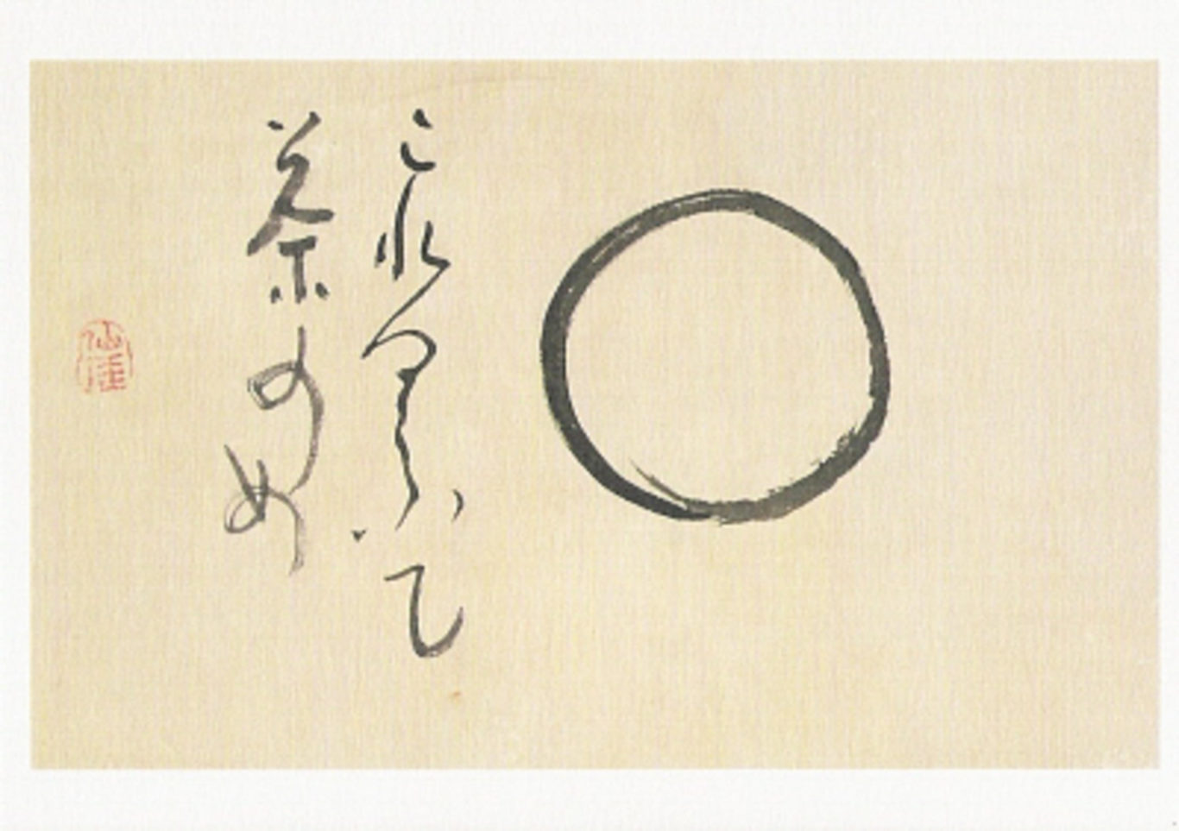
Emptiness
THE ABSENCE OF INTRINSIC EXISTENCE AND NATURE
Notes:
The definition:
Sanskrit – Sunyata
Not absence or nihilism but voidness.
Definition: All things are absent of intrinsic existence and nature
From the root hollow
We are stuffed full of conceptualisation that has brought delusions and karmic creations.
When we realise emptiness then this is snuffed out.
How do we empty ourselves of this vast accumulation of projections from countless lifetimes?
Like a bottomless laundry bag – first there’s todays washing, then gradually you find old socks that have been in there for years
“Consider all things and events as dreamlike” – 1st line of Main Practice
When we wake from a dream we see it is an illusion. If we practise seeing our waking life as an illusion then we disentangle ourselves from our grasping and self cherishing.
See them as mere appearances.
Snake/rope example – the I appears to us, just as a snake appears to be a coiled rope. It doesn’t exist. The snake doesn’t exist – we have projected snake onto the rope.
Fear of lacking a self is behind all our non-virtues. Topic for discussion.

Slide 4
“THE DOOR THAT LEADS US OUT OF SAMSARA IS THE WISDOM THAT REALISES THE EMPTINESS OF SELF-EXISTENCE.” Lama Zopa Rinpoche
IGNORANCE
A consciousness conceiving inherent existence
WISDOM
A consciousness that directly perceives the true reality of all phenomena
Notes:
Reminder:
If the definition of ignorance is “a consciousness conceiving inherent existence” – that which is ego-grasping.
Then the definition of wisdom is “a consciousness that directly perceives the true reality of all phenomena”. The destruction of the ego. It destroys the very root of our delusions.

Slide 5

“This “I” is merely labelled”
The Five Aggregates/Skandhas
Nature of Mind
Dependent Arising
Notes:
From teachings
Teachings that support understanding Emptiness are Buddha’s teachings on
The 5 aggregates, enabling us to see the delusion of the ego
(form, feelings, perceptions, volition, consciousness)
Recognition of the impermanent nature of our mental states through understanding the nature of the mind
Linking this analysis with dependent arising (as depicted on the wheel of life outer rim) – showing the creation of our “I”s

Slide 6
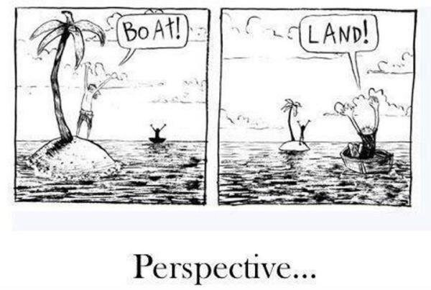
“By holding “self” we hold “other”. Through self and other attachment & aversion arise. And in connection with this all faults arise.”
- Serlingpa Dharmakirti
Notes:
When we understand the view of emptiness (right view) we can withdraw from neurotic self- obsession to develop equanimity, empathy and compassion – destroying self-cherishing
Sp we can see the relationship very clearly of self- grasping with self- cherishing

Slide 7

“Without compassion, there are
personality/ego clashes and other problems:
anger, jealousy, and many other things.
Without compassion, life gets trapped in problems like
a mouse trapped in a cage, an elephant drowning in
mud, or a fly who flies into a spider's web and gets
completely caught.
Life gets completely caught up in problems
and continues like that until you die –
just like that fly.
Therefore, compassion is the most important practice
in life and the most important meditation.”
Notes:
Quotation from Lama Zopa
Recognition that compassion is essential to destroying the self-cherishing mind.
This actually means that it is others that enable us to become enlightened- that’s interdependence.
We are all connected. Without others we could not practise compassion
Practice because it’s not just about feeling compassion for some but recognising the suffering nature of samsara for all beings and making the vow to stay in samsara until it is empty of sentient beings.
When compassion becomes bodhicitta we are bodhisattvas – the wish to benefit others and lead them all to enlightenment.

Slide 8

Generating Bodhicitta the totally open heart
Recognition of all beings as our mothers
Remembering their kindness
Wishing to repay their kindness
Equalising and exchanging self with others
Recognition of the shortcomings of self-cherishing
Recognition of the benefits of cherishing others
Giving and taking –the practice of great love and great compassion
Bodhicitta
Notes:
7 POINT METHOD TO CULTIVATE BODHICITTA
Recognising all sentient beings as our mother or as having strongly benefitted us
Remembering their kindness
Wish to repay their kindness
Equalising and exchanging self with others
Recognition of the benefits of cherishing others
Extraordinary thought of resolve – taking on the responsibility –Giving and taking
Bodhicitta: benefitting others by attaining enlightenment; continuing to benefit others
At the foundation of this practice is to develop EQUANIMITY – without which there is no genuine compassion. Topic for discussion
Lama Tsong Khapa combined these 2 methods into the 11 point METHOD TO CULTIVATE BODHICITTA
+ Equanimity
Recognising all sentient beings as our mother or as having strongly benefitted us (Asanga’s lineage)
Remembering their kindness
Wish to repay their kindness
Equalising and exchanging oneself with others (Nagarjuna’s lineage
Recognising the disadvantages of self-cherishing
Recognising the advantages of cherishing others
+ Actual exchanging self with others (leading to the practice of Tong Len)
Taking and Giving the practice of great love and great compassion
+ Extraordinary thought of resolve – taking on the responsibility
Bodhicitta: benefitting others by attaining enlightenment; continuing to benefit others
The Equanimity meditation – friend, enemy, stranger
It is a very effective psychological method to subdue and transform the negative mind.

Slide 9
Giving and Taking The Practice of TONGLEN
Three Objects that we are attracted, repelled or indifferent to
Three Poisons of ignorance, attachment and aversion
Three Virtues the roots are detachment, equanimity and wisdom
Train in taking first
Notes:
“Practising kindness – creates an enduring affection from your heart and brings strong joy.” Serkong Rinpoche.
Post meditation – off the cushion – practise with the three types – and “positive statements will spill from our lips” – applying the slogans
If we are attached to someone or something – then view the object with wisdom. Remove yourself to be more objective. Remember equanimity and the interdependent play of relationships and things. Think of impermanence. We are using the full wisdom of the Dharma to let go a little and gain a more realistic approach.
Attachment may come from habit and fear of change. Fear of losing something or someone precious can lead to extreme behaviour
Great Love-immeasurable
Great Compassion - immeasurable
Extraordinary thought of resolve – taking on the responsibility
Bodhicitta: benefitting others by attaining enlightenment; continuing to benefit others
At the foundation of this practice is to develop EQUANIMITY – without which there is no genuine compassion – the usual attitude is to love those who are close to us
Tong Len – Taking and giving - Very secret practice. Too profound for the lay community. Lepers approached Lamas who out of compassion gave them the practice and it helped many of them cure their disease.

Slide 10

Destroying self grasping destroying self cherishing
“For as long as space remains,
For as long as sentient beings remain,
Until then may I too remain
To dispel the miseries of the world.”
Shantideva
Notes:
B’citta and wisdom are known as the two wings of enlightened mind
Fully enlightened – Wisdom and Bodhicitta.
Liberation is not full enlightenment
Mahayana Buddhism states that to be fully enlightened one needs to develop both qualities side by side
Theravadan Buddhism goes for liberation first.
Shantideva’s Guide to the Bodhisattva Way of Life
From Chapter 10 Master Shantideva’s Bodhicharyavatara
700AD, Indian Buddhist monk wrote it at Nalanda.
Also born a Prince who renounced it all.
“His fellow monks observed that Shantideva seemed to spend his time doing nothing other than sleeping, eating, and wandering about. Judging him to be lazy or to be wasting the generosity of the monastery's patrons, they hatched a plan to expel him: Every week at Nalanda a public teaching was given, usually by one of the senior monks. Thinking to shame Shantideva into leaving, the monks requested that he give the weekly teaching. After declining their first few requests, to their surprise, he finally agreed. On the appointed day, he took his place on the teaching throne set up in front of the monastery. He asked those congregated if they would rather hear a well-known teaching or one they had never heard before. Curious, and perhaps hopeful at the prospect of Shantideva demonstrating his lack of knowledge and diligence in front of a large audience, they asked for a new teaching.
And they were amazed.”

