Slide 1
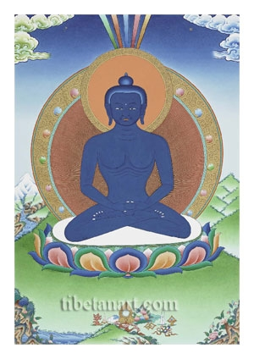
THE BODIES OF A BUDDHA
whowWOm
POINT THREE
TRANSFORMING ADVERSITY INTO THE PATH OF ENLIGHTENMENT
TRUTH BODIES
The Dharmakaya – or Truth Body
The Svbhavikakaya - Nature body
FORM BODIES
3. The Sambhogakaya – or Enjoyment Body
4. The Nirmanakaya – or Emanation Body
1
Notes:
Transforming adversity into the path of enlightenment – in this point we focus on seeing delusory perceptions as the four kayas. It is a method to destroy ego-centredness and to transform the evil and trouble that we see into our path – so that we carry the path with us.
Blame our self-cherishing and have gratitude for the kindness of others.
“Meditating on delusory perceptions as the four kayas” protects sunyata – the view of emptiness
Bold sourced from Chogyam Trungpa.
When a being attains full enlightenment, they attain the holy bodies of a buddha:
This is particularly taught in the Vajrayana vehicle
1. The Dharmakaya – or Truth body – eternal, indestructible, true principle
2. The Svbhavikakaya - or Nature body - a final state with two purities
2. The Sambhogakaya – or Enjoyment body – heavenly mode of being – a manifestation of the Truth body
3. The Nirmanakaya – or Emanation body - earthly mode of being - a manifestation of the Truth body
Rupakaya is a term used to describe the form bodies
This is an image of Samantabhadra
Samantabhadra is also known as the Primordial body from which all other buddhas have manifested.
The colour blue symbolizes the expansive, unchanging quality of space, which is the ground of all arisings, the basis of all appearances, and the source of all phenomena. The absence of robes symbolizes the genuine reality beyond any dualistic, conceptual, or philosophical clothing. That is the dharmakaya buddha: the genuine body of absolute truth
1

Slide 2

THE WISDOM TRUTH BODY
whowWOm
“OMNISCIENT, EVERLASTING, PEACEFUL, WHOSE CHARACTERISTIC IS IN THE NATURE OF WISDOM.”
Lama Thubten Yeshe
A final wisdom consciousness that perceives conventional and ultimate truths, and all objects of knowledge.
The Dharmakaya
2
Notes:
Perceptions has four stages:
The dharmakaya aspect of our minds is basic openness. This is the first stage
The ultimate reality of a buddha’s enlightened mind, which is unborn, empty of true existence, free from conceptual thought, naturally radiant, beyond duality and spacious like the sky.
One of the three kayas, the Dharmakaya can be divided into:
a) Jnanakaya or wisdom body (the blissful omniscient mind of a buddha) and
b) svabhavikakaya or nature body (the emptiness of the buddha's mind). The nature dharmakaya is like a precious statue. Just as a whole statue comes into view when its cover (the defilements) are removed, so does it appear in its entirety when the mind is freed from delusions.
Dharmakaya is Truth Body (dharmakaya and svabhavikakaya)
Rupakaya is Form Body (samboghakaya and nirmanakaya)
The Truth Body is a mental continuum that rests in the state of uninterrupted meditative equipoise
The forms that emanate from it also function in a continuum
i.e. the forms are also born and pass away in the world
2

Slide 3
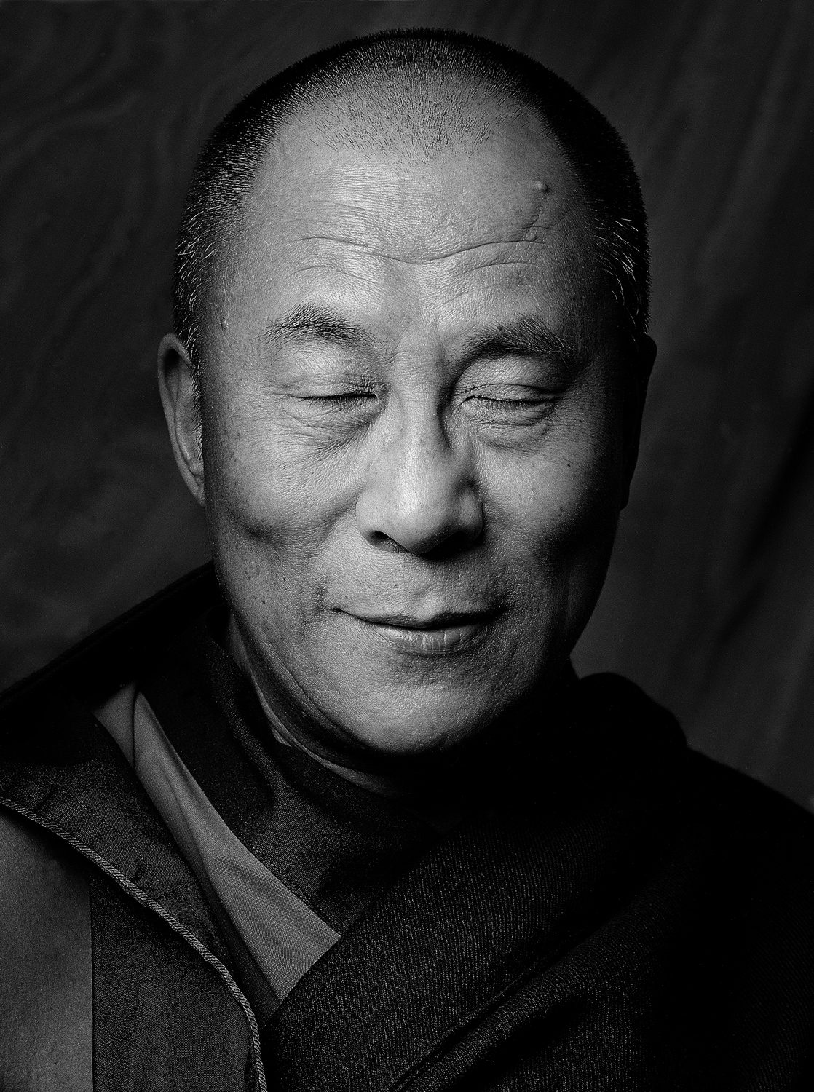
THE EMANATION BODY
A final form body not having the five characteristics, that spontaneously performs the Buddha’s actions of teachings, blessing, guiding, healing and helping sentient beings.
The Nirmanakaya
Supreme emanation body: Guru Shakyamuni Buddha with all the signs and marks and who performs the 12 deeds of a Buddha
Artisan Emanation Body: e.g. musician, artist craftsman
Incarnation emanation body: any incarnation or inanimate form the Buddha may take to benefit beings
3
Notes:
The Nirmanakaya aspect of our minds is the second stage – there is some clarity. A general grasp of a situation
Not having the 5 characteristics of the Enjoyment Body (next slide)
Guru Shakyamuni Buddha came to teach beings so is known as the supreme emanation body.
The 12 deeds of a buddha are:
Descending from Tushita Heaven: The Buddha descended from Tushita Heaven.
Entering the womb: The Buddha entered the womb of his mother.
Birth: The Buddha was born in the garden of Lumbini.
Training: The Buddha trained in the sciences and was renowned in his knowledge.
Sports victory: The Buddha won a sports competition – he was renowned as an athlete.
Palace and marriage: The Buddha enjoyed the delights of hedonism in the palace and married.
Renunciation: The Buddha renounced his life as a prince.
Austerity: The Buddha practiced austerity for six years, then gave it up.
Victory over Mara: The Buddha overcame the Maras/temptations.
Enlightenment: The Buddha became enlightened under the bodhi tree.
Turning the wheel of dharma: The Buddha turned the wheel of dharma.
Parinirvana: The Buddha passed into Parinirvana.
The Buddha's deeds are said to teach that anyone can attain enlightenment, regardless of their birth. For example, his departure from his family and palace, and his passing into Parinirvana, are said to teach his disciples about impermanence and renunciation.
Basically, the 12 deeds are there to show us that all the things one wishes for in a lifetime are actually devoid of genuine happiness and only lead to more suffering. One could compare it to the life of a handsome, talented celebrity today, with 1 million followers on Instagram, but continually trying to improve their social media profile!
Artisan emanation body: will appear to help sentient beings – an artist, a writer
Incarnation emanation body – Tulkus, HH Dalai Lama, or even manifesting as a bird, a rock, a tree, if it will help sentient beings who have just a little dust in their eyes. Any event that moves the mind towards the truth of reality may have the intervention of a Nrmanakaya.
3

Slide 4
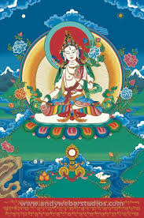
THE COMPLETE ENJOYMENT BODY
The Sambhogakaya
A final form body, possessing the five definitive characteristics
Definite abode – in Akanista pure realm
Definite body – 32 major marks and 80 minor signs of a prefect being
Definite retinue – whose followers are superior bodhisattvas, not ordinary beings
Definite teachings – teaches only Mahayana teachings
Definite time – abides – no death or rebirth until samsara ends
4
Notes:
The third aspect is the link between openness and understanding/clarity of a situation – Sambhogakaya that bridges the gap between dharmakaya and nirmanakaya and joins them together. This is a realistic way of looking at things. Usually though we start with dharmakaya, then sambhogakaya and then nirmanakaya.
Rupakaya (Skt)
form body; zug ku (Tib); gzugs sku (Wyl)
The form body of a fully enlightened being; the result of the complete and perfect accumulation of merit. It has two aspects:
sambhogakaya (enjoyment body), in which the enlightened mind appears in order to benefit highly realized bodhisattvas, and
nirmanakaya (emanation body), in which the enlightened mind appears in a form that can benefit ordinary beings.
Deities such as this figure of White Tara, the deity of long life, are sambhogakaya
Having achieved the Nature mind when we later actualise the Enjoyment body, we will be like a wealthy monarch who can protect all beings in the land.
Definite Abode: Akanista pure realm is the highest pure abode. There are many. This is where the Enjoyment body teaches the Arya bodhisattvas ( the definite retinue).
Definite Body: They carry marks and signs of a perfect being such as the mark of a dharma wheels on the soles of his feet; long fingers and toes; a large, lion- like torso; sensitive taste buds; white, evenly spaced teeth; a long tongue; etc.
Definite teachings: They teach both Wisdom and Bodhicitta found only in the Mahayana teachings
Definite Time: They will abide until samsara ends. They have taken the bodhisattva vows as referred to when we pray to remain until all sentient beings are liberated from samsara.
4

Slide 5
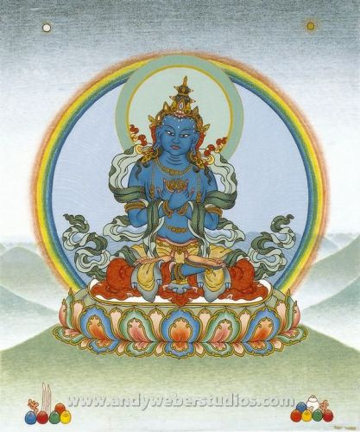
THE NATURE TRUTH BODY
Vajradhara
The Svabhavikakaya
Natural purity: the ultimate true nature of a buddha’s mind
Absence of the adventitious defilements: the obscurations to liberation and omniscience.
A Buddha’s True Cessation
5
Notes:
The fourth state or aspect of mind is the Suabhavikakaya – it’s the whole thing – the total experience.
When we begin to meet and object with our mind and grasp it and realise the link between the three kayas then that is soabhavikakaya
A state of mind that transcends birth, cessation and dwelling . Simply existing and being.
A final state endowed with two purities - nirvana
Sometimes simply called the Nature Body
The essential purity of the mind that is the dharmakaya (truth body).
When the emptiness of our minds is revealed and becomes the nature dharmakaya, our problems are forever pacified.
Vajradhara (Skt)
Dorje Chang (Tib); rdo rje ‘chang (Wyl)
Male meditational deity; the form through which Shakyamuni Buddha revealed the teachings of secret mantra.
The first teacher of Tantra
Also known as the First Buddha or the Primordial Buddha. Another common term for this figure is Dharmakāya Buddha.
5

Slide 6
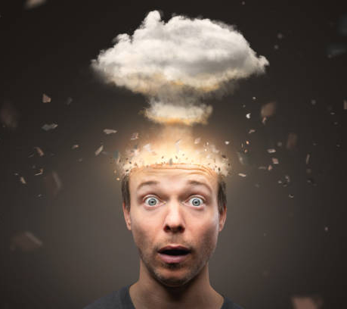
Seeing with pure vision
Practising seeing everyone and everything as pure
The manifestation of buddhas for our benefit
Utilising the view of emptiness to check our attitudes
Notes:
The four kayas are great protection in that we start to realise how our minds function. Thoughts do not come up they simply emerge. You cannot watch their birth – they are just there. Everything is Nowness – Nature. This is called shunyata protection. – it cuts the solidness of our beliefs. All our thoughts, schemes, ideas are empty. There is nothing to protect.
Namaste – I greet the god within you
Buddhas manifesting to guide us
Seeing things as lacking inherent existence is the ultimate protection
Langri Tangpa – “All faults are one’s own. All qualities belong to others”
We get angry with the person instead of with the mental disturbance.
We blame the person.
“Drive all blames into one” – self cherishing
Instead “Meditate on the great kindness of all”
Resources:
Samsara, Nirvana and Buddha Nature, The Dalai Lama and Thubten Chodron, Wisdom Publications
Extended Lam-Rim Outlines, compiled by Karin Valham
www. fpmt.org
The Bodhisattva Path of Wisdom and Compassion, Chogyam Trungpa
6

Slide 7
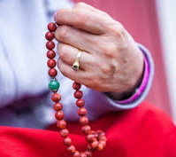
THE FOURFOLD PRACTICE
“The fourfold practice is the best of methods. Whatever you encounter, apply the practice.”
Accumulation of Merit
Purification
Making Offerings
Training in the Four Practices
7
Notes:
Prayers, mantra recitation, circumambulation ACCUMULATION OF MERIT
3 lines of encouragement:
Grant your blessing so if it is better for me to be sick, let me be sick
Grant your blessing so if it is better for me to survive, let me survive
Grant your blessing so if it is better for me to be dead, let me be die
A quality of openness, giving and surrendering
Purification using the Four Powers: Regret, Refuge, Remedy, Resolve/Restraint. Vajrasattva as the deity of purification PURIFICATION
Offerings to Dharma Protectors, Buddhas, Teachers MAKING OFFERINGS
4 practices:
through tonglen and exchanging self with others;
relying on accumulation of merit and wisdom;
consistency and mindfulness;
strengthening consistency and determination TRAINING IN THE FOUR PRACTICES
7

Slide 8
FOR DISCUSSION
All our past history, all our neurosis, is related with others. All our experiences are based on others…….
Without them, we could not attain anything. We would have no feedback, absolutely nothing to work with. So the irritations and problems in our world are crucial.”
Trungpa
How does meditating on delusory perceptions as the four kayas
protect our view of emptiness?
Discuss the fourfold practices and how you relate to them.
.
.
8
Notes:
8

